Slide 1





































CH 3101 - 2025

Slide 2
Syllabus
Nomenclature and isomerism: structures and isomers of coordination compounds
CFSE and Structural effects: Jahn-Teller Distortions,
Bonding in metal complexes: ML 4 and ML 6 MO types (sigma donor-pi donor, sigma donor, sigma donor-pi acceptor) Ligand Field Theory: Symmetry and Group Theoretical approach, spectrochemical series and its correlation to the MO diagram, metal carbonyl bonding, metal olefin bonding, MO diagram of Ferrocene, Metal-Metal Bond
Microstates, selection rule, Hunds rule, Orgel diagram, Tanabe-Sugano diagrams ( 1 L), Spin-states, Interpretation of Spectra d 1 -d 9 (Octahedral, Tetrahedral, high-spin, low spin, Charge-transfer Spectra,
Orbital and spin magnetic moments, spin only moments of d n ions and their correlation with effective magnetic moments, Curie law, para-ferro, anti-ferro and ferri-magnetic systems, Oxidation States and Structural trends, Representative compounds, Lanthanides and Actinides Reaction mechanism of complexes: Inorganic Reaction Mechanisms, Ligand Substitution Reaction, Kinetics, Stereochemical aspects of Octahedral, Square-Planar complexes, Trans effect, Isomerization reactions, Inner-sphere reaction, Outer-sphere reaction, Marcus Equation, Robin-Day Classification, Electrophilic Substitutions, Photochemical reactions, Photochemistry of [Ru(bpy)₃]²⁺ and related complexes.

Slide 3
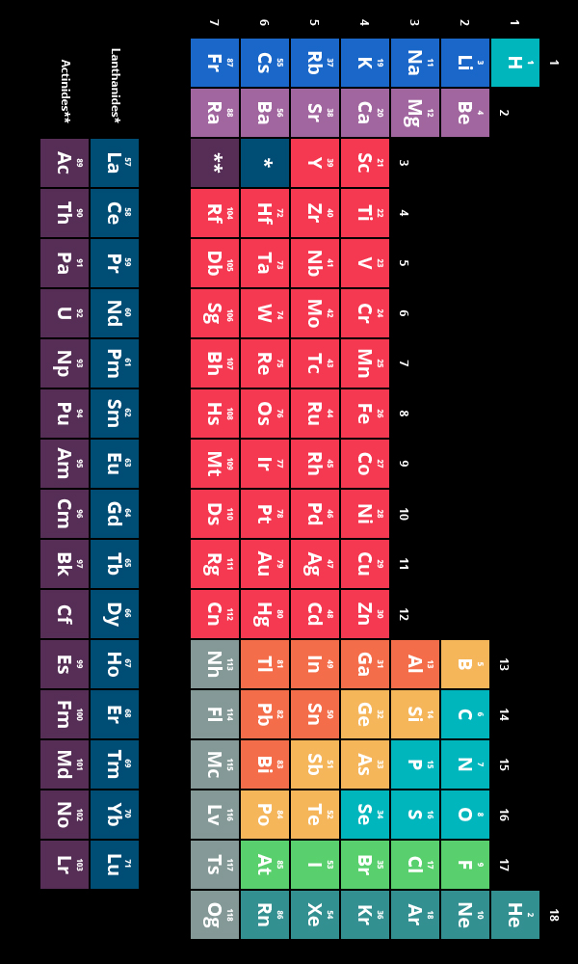
Transition metals

Slide 4
MARKS DISTRIBUTUION
70 + 30
MID SEM(20) + END SEM (25)
+
3 Class Tests (each 20 Marks)
(Best two: 40 scaled down to (25)

Slide 5
BOOKS

Slide 6
NOMENCLATURE
Metal
Ligand
Denticity
Bridging

Slide 7
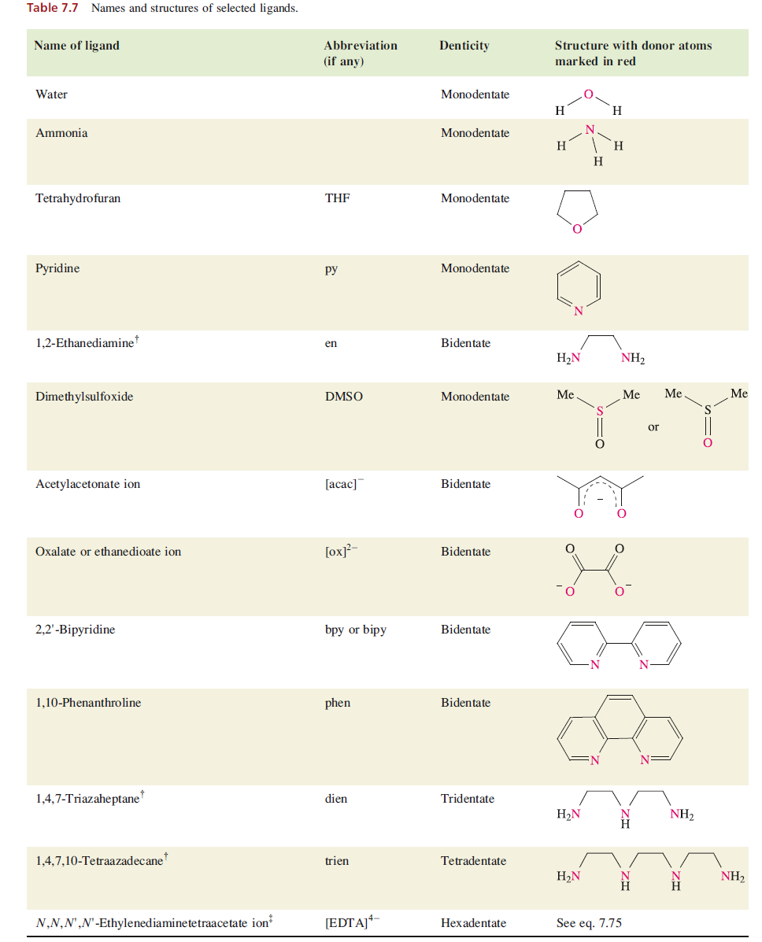

Slide 9
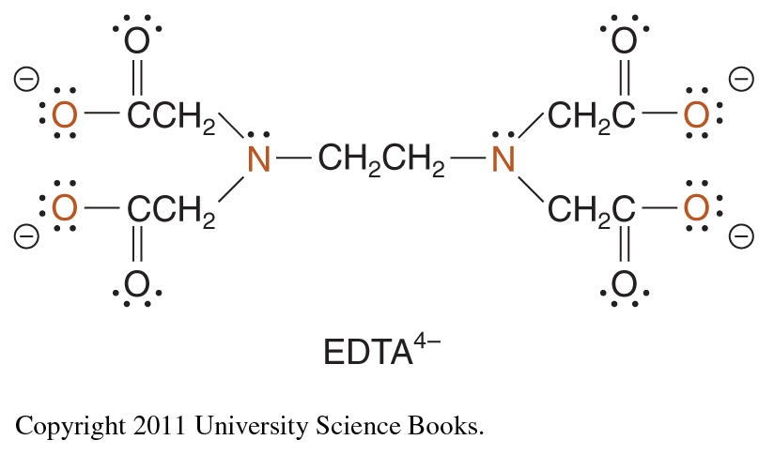
A polydentate ligand is a chelating agent,
complexes containing polydentate ligands:
Ethylenediaminetetraacetate ion:
hexadentate ligand

Slide 10

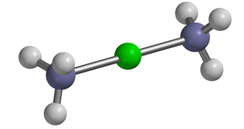
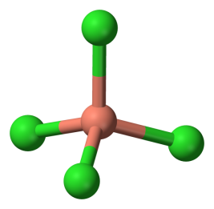
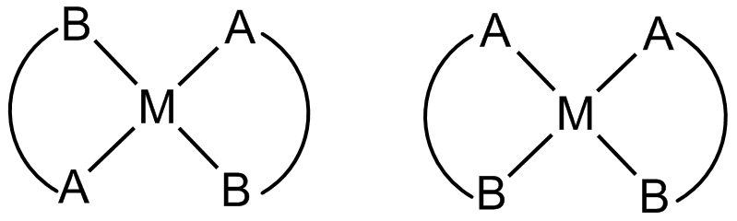
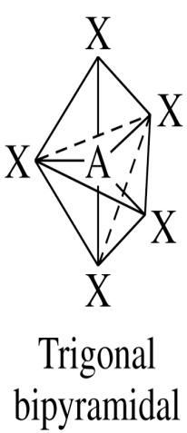
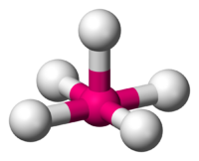
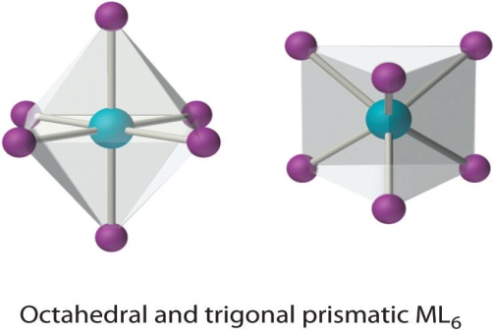
Basic Structure of Metal – Ligand Complex
Monodentate Ligand
Coordination # 4
Two common structures:
tetrahedral & square planar
Tetrahedral: all 4-coordinate complexes of
non-transition metals and d¹⁰ ions and first-row transition metals,
Coordination # 2 = linear
Rare for most metals;
common for d¹⁰ metal ions,
especially: Cu⁺, Ag⁺, Au⁺, and Hg²⁺
Coordination # 3
Encountered with d¹⁰ metal ions e.g.Cu⁺ & Hg²⁺
Square planar: 4-coordinate complexes of
2nd & 3rd row transition metals with d⁸ e⁻ configurations,
e.g. Rh⁺ , Pt²⁺ and Pd²⁺,
also encountered in some Ni²⁺ & Cu²⁺ complexes
Coordination # 5
trigonal planar structure
Coordination # 6
Most common: six ligands at vertices of an octahedron or a distorted octahedron.

Slide 11
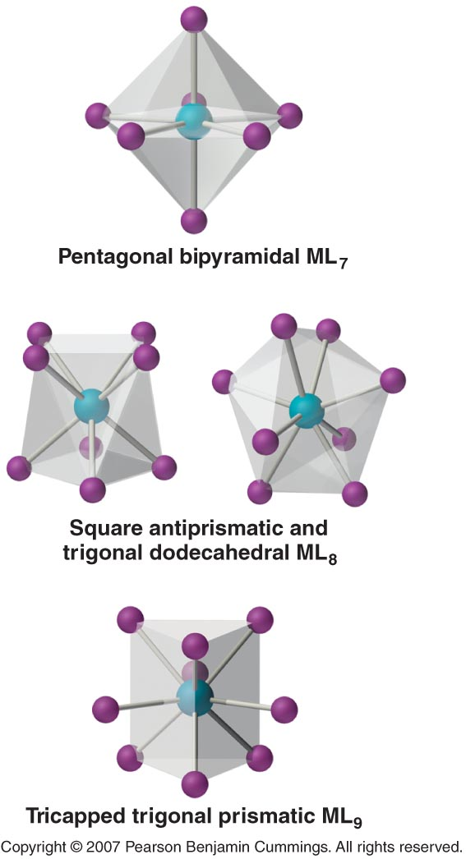
… and 2nd & 3rd row transition metals
7, 8 & 9
coordination #’s,
give other geometries

Slide 12
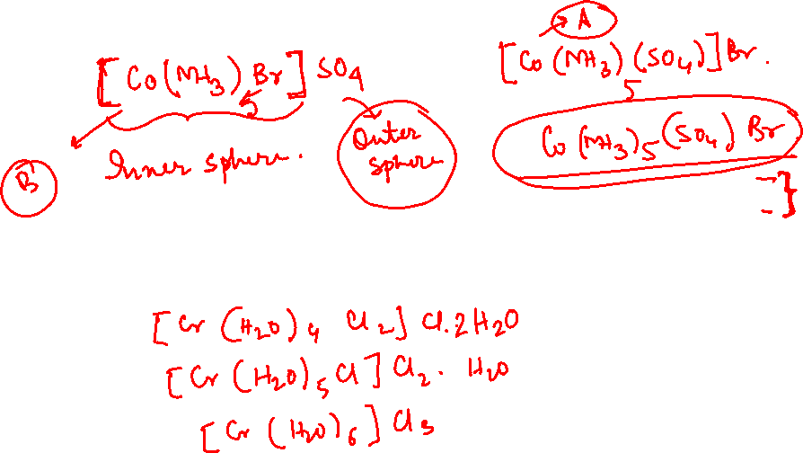
ISOMERISM
Structural isomerism
1. Ionization isomers : Interchange of an anionic ligand within the first coordination sphere with an anion outside the coordination sphere.
2. Hydration isomers : Hydration isomers result from the interchange of H2O and
another ligand between the first coordination sphere and the ligands outside it.

Slide 13
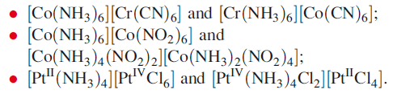
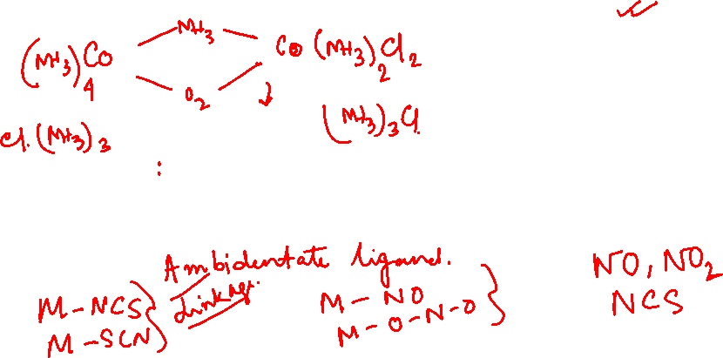
Structural isomerism continues….
3. Coordination isomerism: Coordination isomers are possible only for salts in which both cation and anion are complex ions
(Coordination position isomerism: In some of the polynuclear complexes, interchange of the ligands between the two metal nuclei takes place, which is give to rice to coordination position isomerism
4. Linkage isomers Linkage isomers may arise when one or more of the ligands can coordinate to the metal ion in more than one way, e.g. in [SCN] both the N and S atoms are potential donor sites. Such a ligand is ambidentate.

Slide 14
5. Polymerization Isomer: The empirical formula obtained from elemental analysis identifies the ratio of components, not their actual number. Thus an empirical formula MA2B2 could be considered as any of [MA₂B₂]_{n} (for n=1, 2, 3, . . .), a series of compounds with the same empirical formula, and with the molecular formula of each some multiple of the simplest formula

Slide 15
6. Ligand isomerism: Some of the ligands themselves are capable of existing as isomers, e.g. diaminopropane can exist isomers as 1, 2-diaminopropane (pn) and 1, 3-diaminopropane (tn).
[Co(pn)₂Cl₂]⁺ and [Co(tn)₂Cl₂]⁺

Slide 16

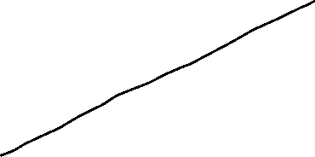





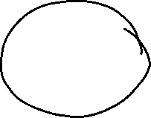

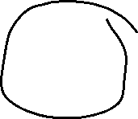


Stereoisomerism: diastereoisomers
Stereoisomers are molecules of the same empirical formula that have identical coordination number and basic shape, and display the same atom-to-atom bonding sequence throughout, but in which the ligand atoms differ in their locations in space.

Slide 17
Diastereomers are the general class of stereoisomers, and includes geometric isomers (such as cis, trans isomeric forms) as a sub-class.
Any particular diastereomer may have an enantiomer, which is a stereoisomer that is a non-superimposable mirror image of the original diastereomer
Not all compounds will exist as two mirror image forms (the enantiomers), as it is a property related to the symmetry of the compound; consequently, diastereomers are not the same thing as enantiomers.
For complexes to have enantiomers, they must be either asymmetric (that is be a molecule totally lacking in symmetry apart from the identity operation) or dissymmetric (that is lacking an Sn axis, which is a rotation-reflection axis – without an Sn axis, it can have neither a plane of symmetry nor a centre of symmetry; however, a dissymmetric molecule can have a proper axis of rotation, Cn (n 1)).

Slide 18

A molecule that is asymmetric or dissymmetric (and therefore not superimposable on its mirror image) is called a chiral compound; this means that all enantiomers are chiral.
Such a compound will display optical activity as an individual enantiomer, which is the ability to rotate the plane of plane-polarized light (measured using a polarimeter), which is one way that we can detect the presence of an enantiomer and define its optical purity.
Whereas diastereomers usually differ appreciably in their chemical and physical properties, enantiomers differ only in their ability to rotate polarized light and related optical properties

Slide 19
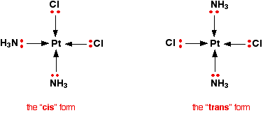
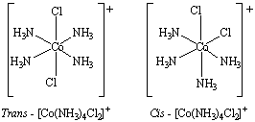
Metal complexes that differ only in which ligands are
adjacent to one another (cis)
or
directly across from one another (trans).

Slide 20
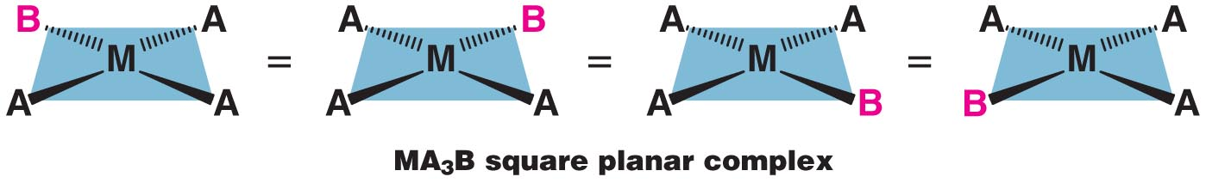
Geometrical isomers
Square planar complexes:
all vertices of a square are equivalent,
it does not matter which vertex is occupied by ligand B
in a square planar MA₃B complex.
Only one geometrical isomer is possible

Slide 21
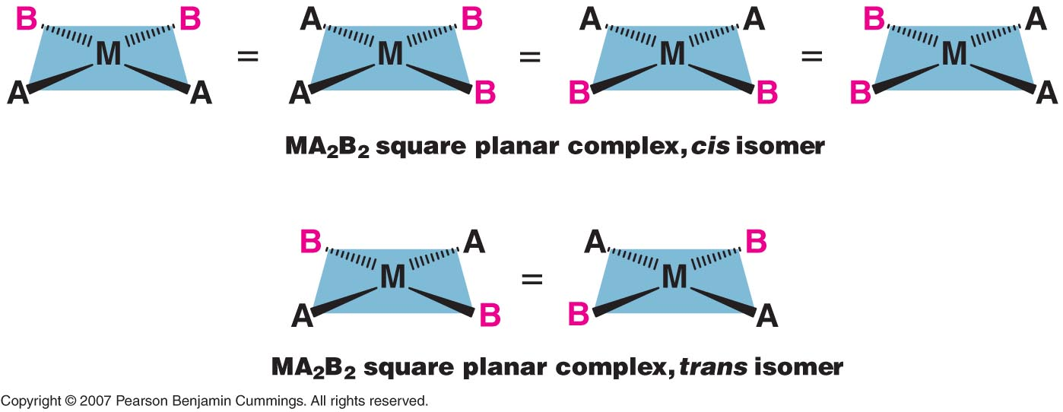
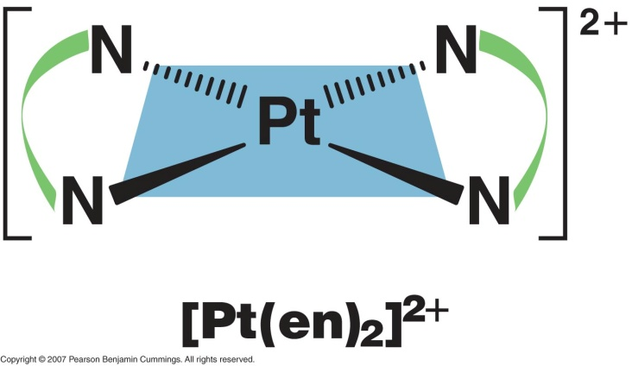
With two, there are other possible arrangements
Symmetrical bidentate ligands also only have one structure

Slide 22
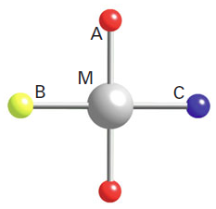
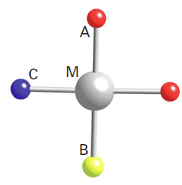
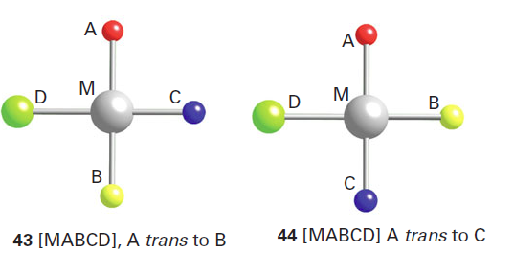
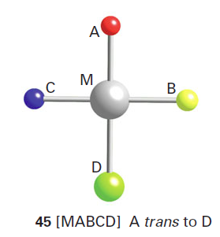
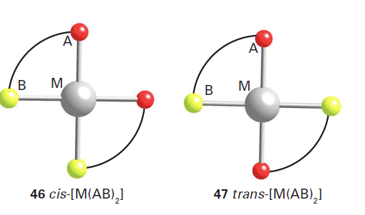
cis-[MA₂BC]
trans-[MA₂BC]

Slide 23
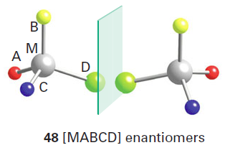
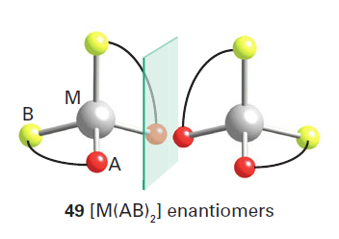

Slide 24
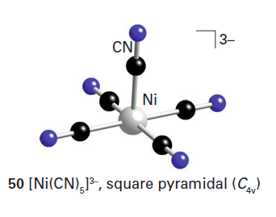
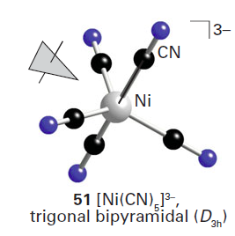
The energies of the various geometries of five-coordinate complexes often differ little from one another. The delicacy of this balance is underlined by the fact that [Ni(CN)₅]³⁻ can exist as both square-pyramidal and trigonal-bipyramidal conformations in the same crystal.
In solution, trigonal-bipyramidal complexes with monodentate ligands are often highly fluxional (that is, able to twist into different shapes), so a ligand that is axial at one moment becomes equatorial at the next moment: the conversion from one stereochemistry to another may occur by a Berry pseudorotation. Thus, although isomers of five-coordinate complexes do exist, they are commonly not separable.

Slide 25
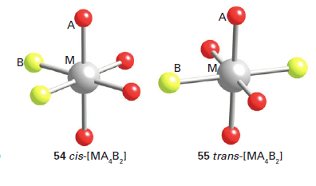
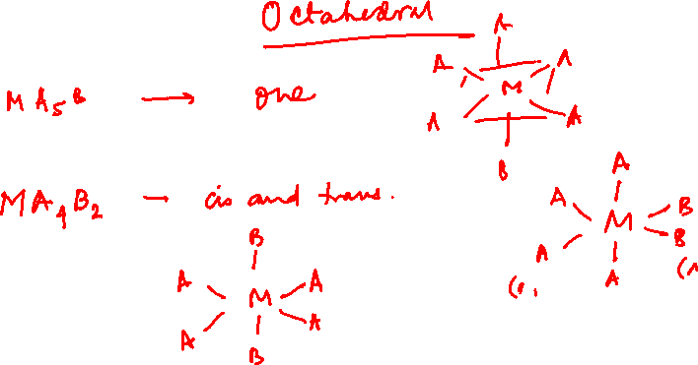

Slide 26
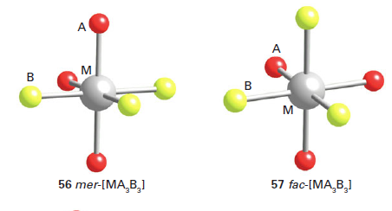
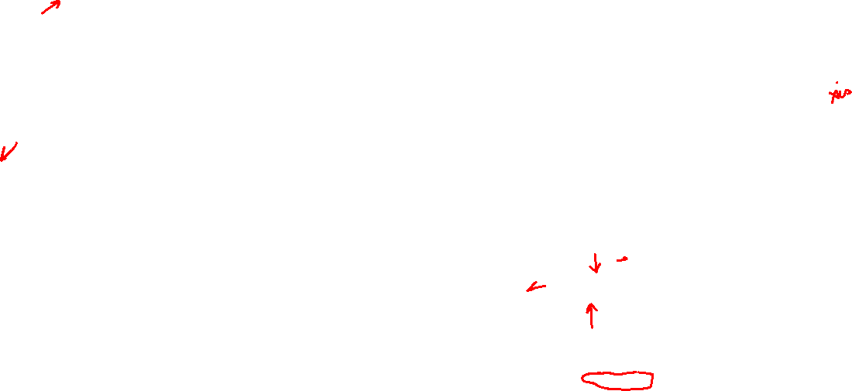
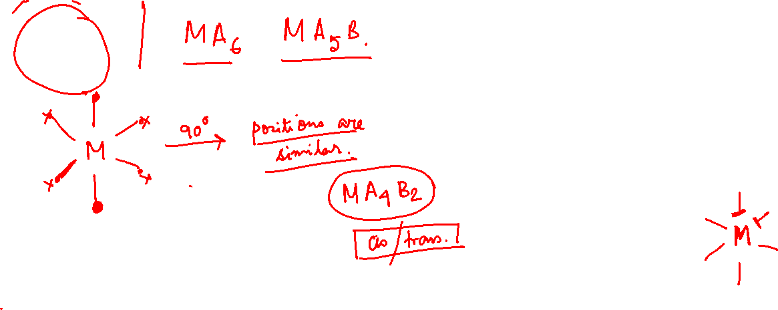
MA₃B₃

